Slide 1
Introduction to Machine Learning
Session 4
For TUM PhD students
Claudia Serrano Colome
claudiaserranocolome@gmail.com

Slide 2
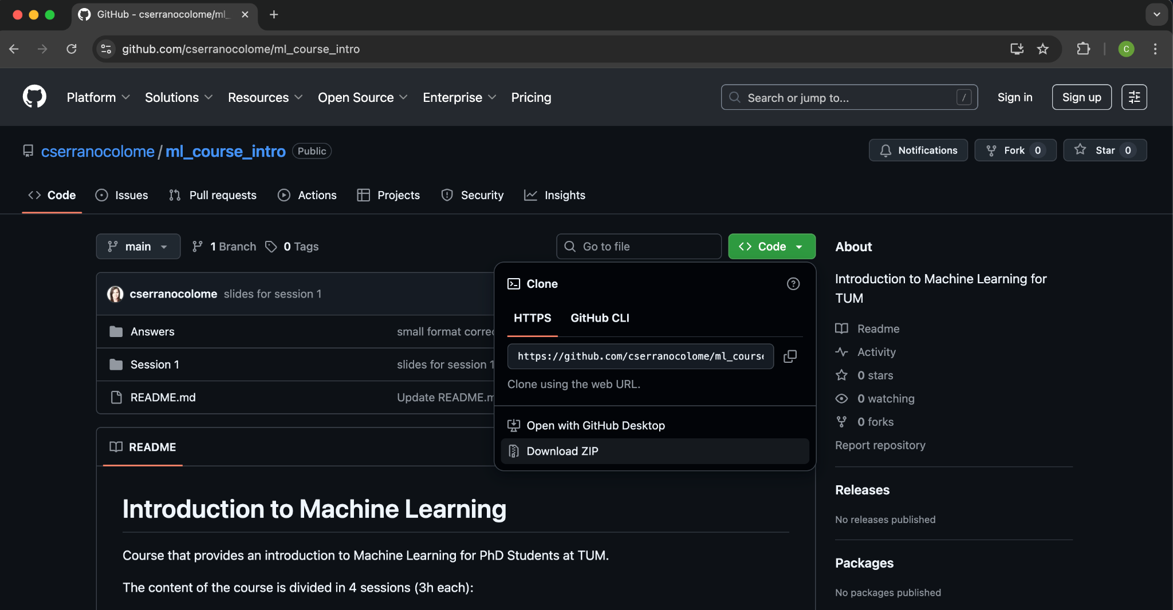
Github
Navigate to https://github.com/cserranocolome/ml_course_intro
Download the materials for the session

Slide 3
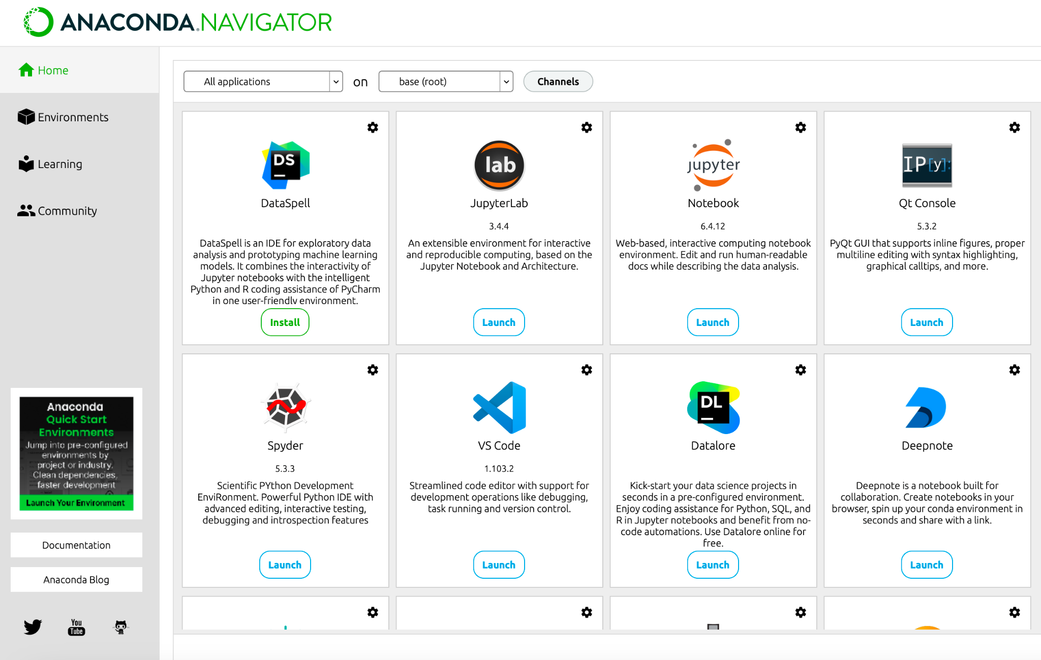
Anaconda Navigator
Start Anaconda Navigator and click on Launch under the jupyter notebook tool

Slide 4
Recap from last session
Unsupervised Learning concepts
Dimensionality Reduction
  PCA
  t-SNE
  UMAP
Clustering methods
  Distance Metrics
  k-Means Algorithm
  Choosing Number of Clusters (k)
  Hierarchical Clustering

Slide 5
Today's session outlook
Why Evaluation Matters
  When is a model good
Train/Test split
  Cross-validation
Types of evaluation
  Regression metrics
  Classification metrics: Confusion matrix
  ROC/AUC curve
New Additions
Mini Project

Slide 6
New additions
Multicollinearity metrics
Time series models

Slide 7
Why Evaluation Matters
Building a model is easy. Knowing if it works is the real challenge.
Poor evaluation → Misleading conclusions → Unreliable research
Good evaluation ensures:
Reproducibility
Generalization
Scientific Validity

Slide 8
When is a model good
Depends on the context:
Scientific interpretability
Baseline comparison
Cost of wrong predictions
Sometimes a simple model is preferred over a complex one.
Sometimes a better prediction accuracy is preferred.

Slide 9
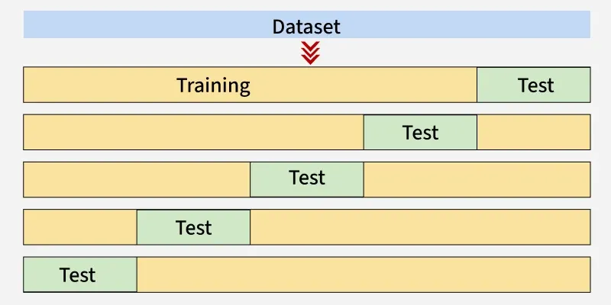
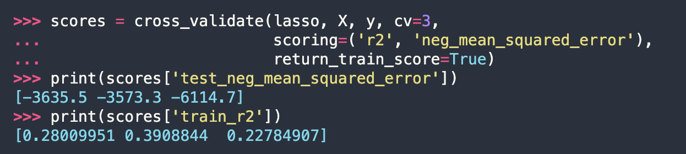
Train/Test split
k-fold cross-validation
k = 5
Source: https://www.geeksforgeeks.org/machine-learning/cross-validation-machine-learning/

Slide 10
Types of Evaluation
Learning Type | Example Metrics | Goal
Regression | MSE, RMSE, MAE, R² | Close numeric predictions
Classification | Accuracy, Precision, Recall, F1, ROC-AUC | Correct class prediction
Clustering | Silhouette Score, Davies-Bouldin | Meaningful grouping

Slide 11
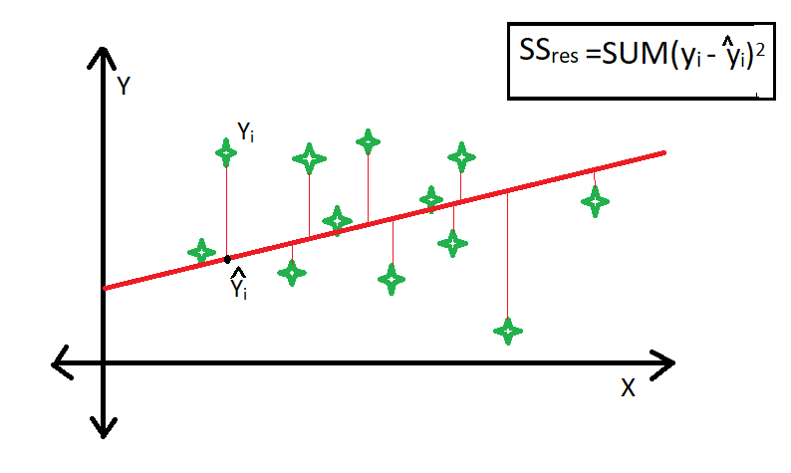
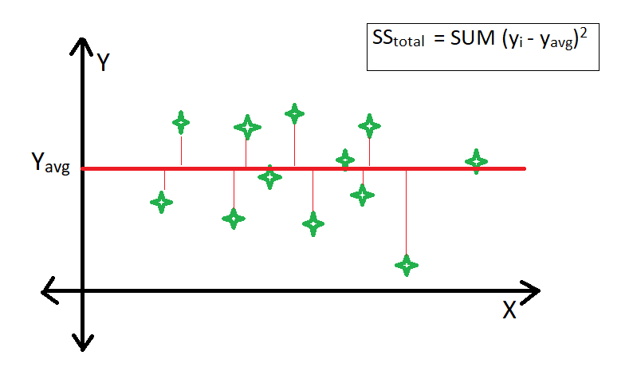
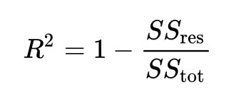
Regression Metrics
Mean Squared Error (MSE): penalizes larger errors
Root Mean Squared Error (RMSE): interpretable in original units
Mean Absolute Error: robust to outliers
R² (Coefficient of Determination): variance explained by the model
Compares the variability explained by the regression model to the total variability in the data that exists without using any model (just the average of the dependent variable).

Slide 12
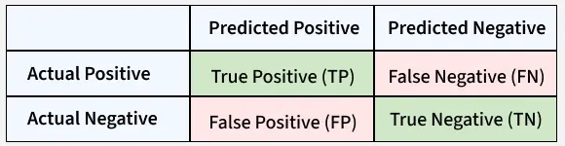
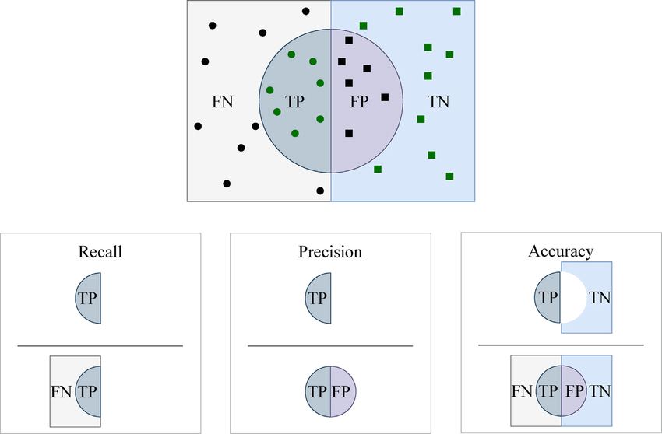
Classification Metrics: Confusion Matrix
TPR = TP/(TP+FN)
FPR = FP/(FP+TN)
Sensitivity or TPR

Slide 13
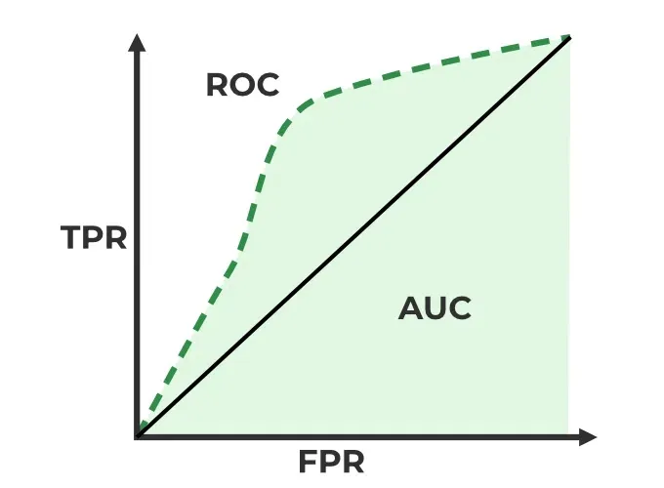
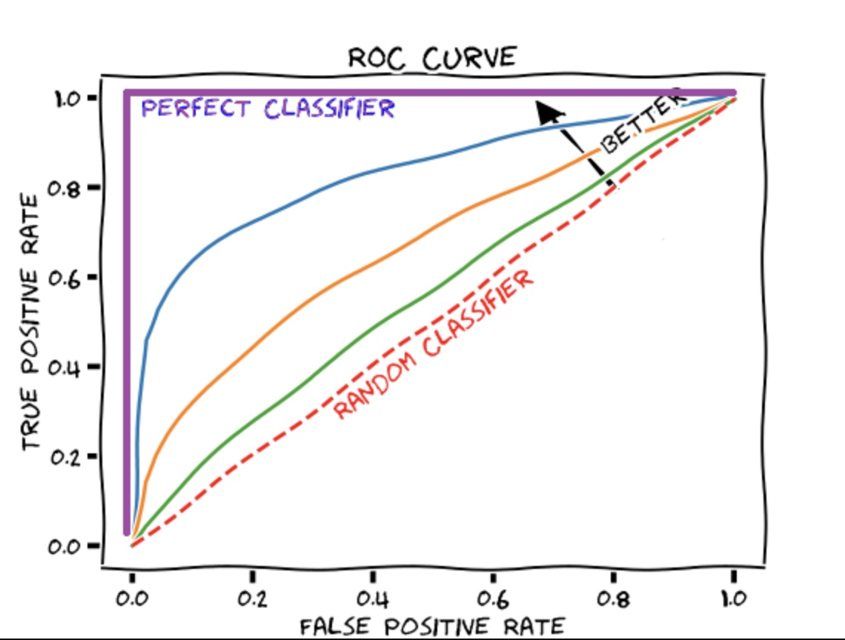
ROC/AUC Curves
They help understand how well a classification model distinguishes between the classes.
ROC Curve: plot TPR vs FDR at different thresholds. Trade-off: There is an inverse relationship.
threshold positive prediction TPR but also FPR.
threshold, TPR but also FPR.
AUC is the area under the ROC curve.
AUC = 1 → perfect performance
AUC = 0.5 → random guessing

Slide 14
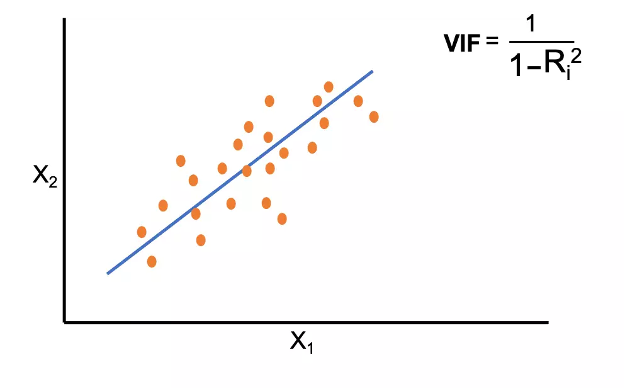
Multicollinearity
Multicollinearity occurs when two or more predictor variables in a dataset are highly linearly correlated — meaning one can be (almost) predicted from another.
If features carry the same information, the model can’t tell which one truly explains the target → it affects interpretability.
If this happens, we might want to drop one of the correlated features, or use a dimensionality reduction technique (such as PCA).

Slide 15
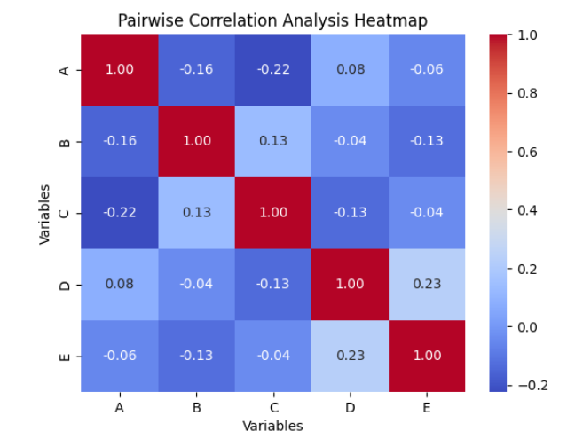
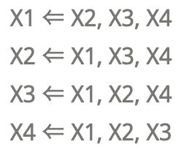
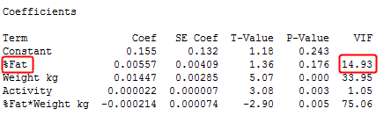
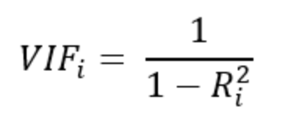
How to Quantify Multicollinearity
Correlation Matrix: pairwise Pearson correlation between variables.
Variance Inflation Factor (VIF):
Compute a linear regression of each variables against all the other ones and compute R²

Slide 16
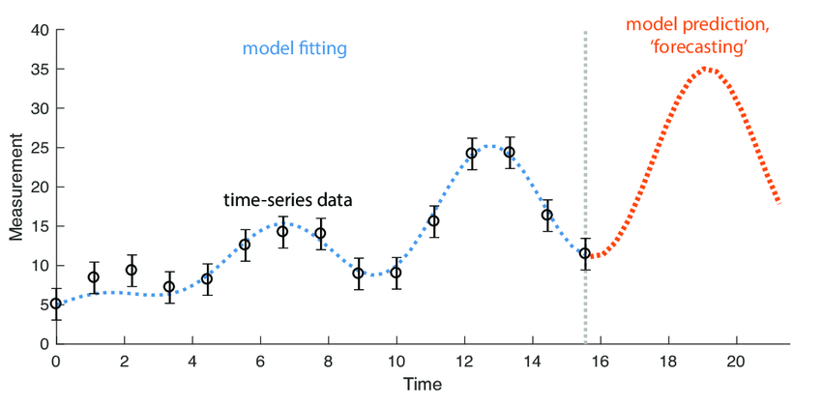
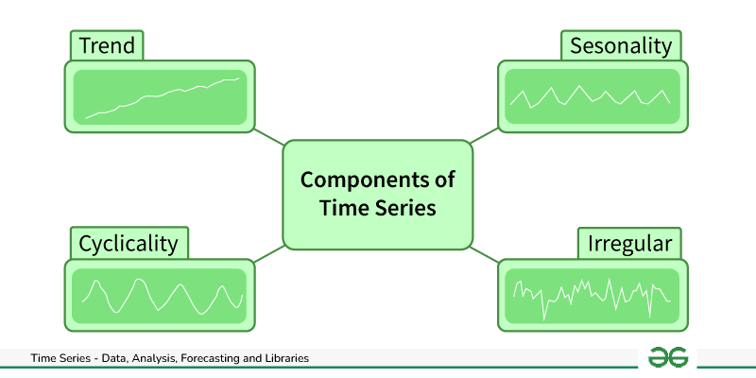
Time Series Models
Long-term increase/decrease
Regular repeating pattern
Long-term fluctuations with no fixed period
Noise, random fluctuations

Slide 17
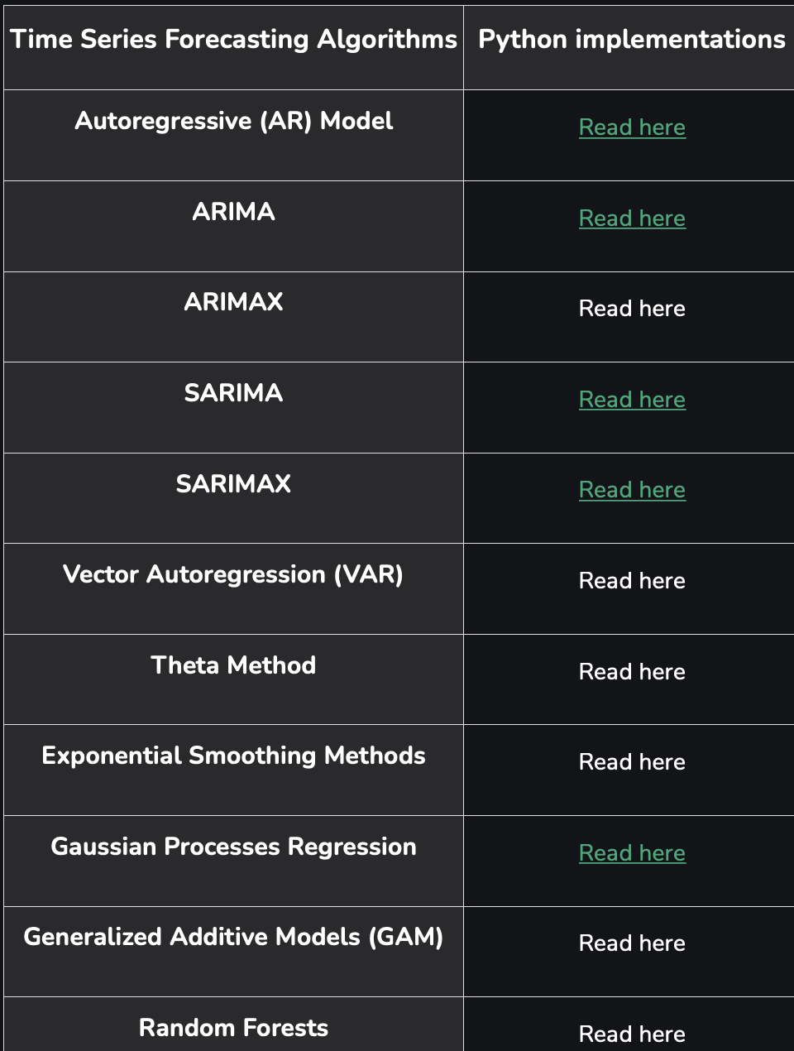
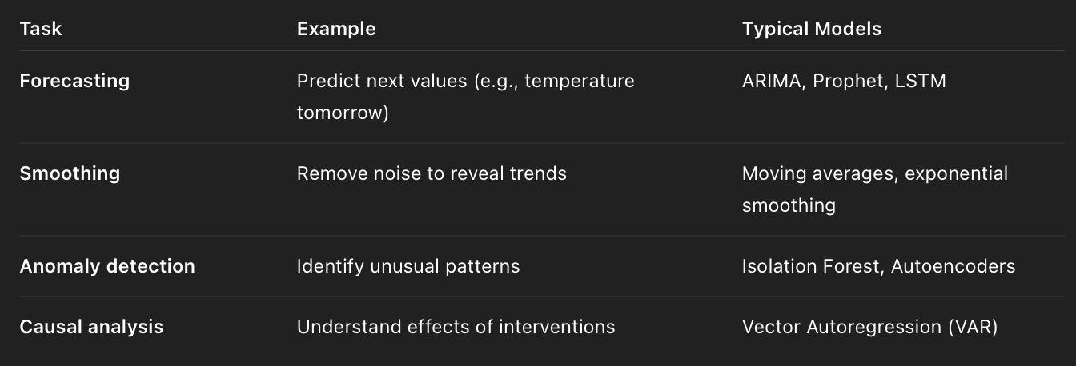
Time Series Models
Depending on the goal of the analysis we would choose different models:
https://www.geeksforgeeks.org/machine-learning/time-series-analysis-and-forecasting/

Slide 18
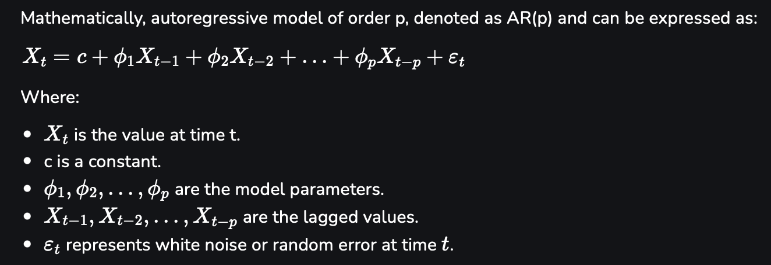
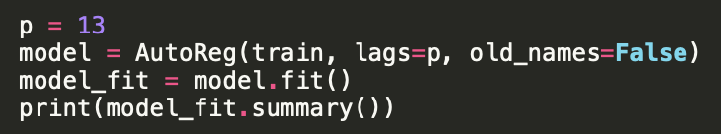
Time Series Models - Autoregressive Model (AR)

Slide 19
Mini Project
You have been provided with data from a clinical study investigating potential biomarkers of disease progression.
The dataset contains patient demographic information, laboratory measurements, and treatment data.
Your task is to:
Preprocess the data as needed.
Explore correlations and decide which features to keep.
Choose and train an appropriate model.
Evaluate your model using relevant metrics.
Interpret which features are most predictive.

Slide 20
Hands On

Slide 21
Additional resources
Train/Test cross-validation
https://www.geeksforgeeks.org/machine-learning/cross-validation-machine-learning/
Coefficient of Determination
https://www.geeksforgeeks.org/machine-learning/ml-r-squared-in-regression-analysis/
Confusion matrix and metrics
https://www.geeksforgeeks.org/machine-learning/confusion-matrix-machine-learning/
AUC/ROC curve
https://www.geeksforgeeks.org/machine-learning/auc-roc-curve/
Time Series Models
https://www.geeksforgeeks.org/machine-learning/time-series-analysis-and-forecasting/
Variance Inflation Factors (VIF)
https://statisticsbyjim.com/regression/variance-inflation-factors/

